Slide 1
How to Write a Resume - Basic Steps

Slide 2
Resume
How to Write a Resume - Basic Steps
Pick the Right Resume Format & Layout
Mention Your Personal Details & Contact Information
Use a Resume Summary or Objective
List Your Work Experience & Achievements
Mention Your Top Soft & Hard Skills
(Optional) Include Additional Resume Sections - Languages, Hobbies, etc.
Tailor Your Information For the Job Ad
Craft a Convincing Cover Letter
Proofread Your Resume and Cover Letter

Slide 3
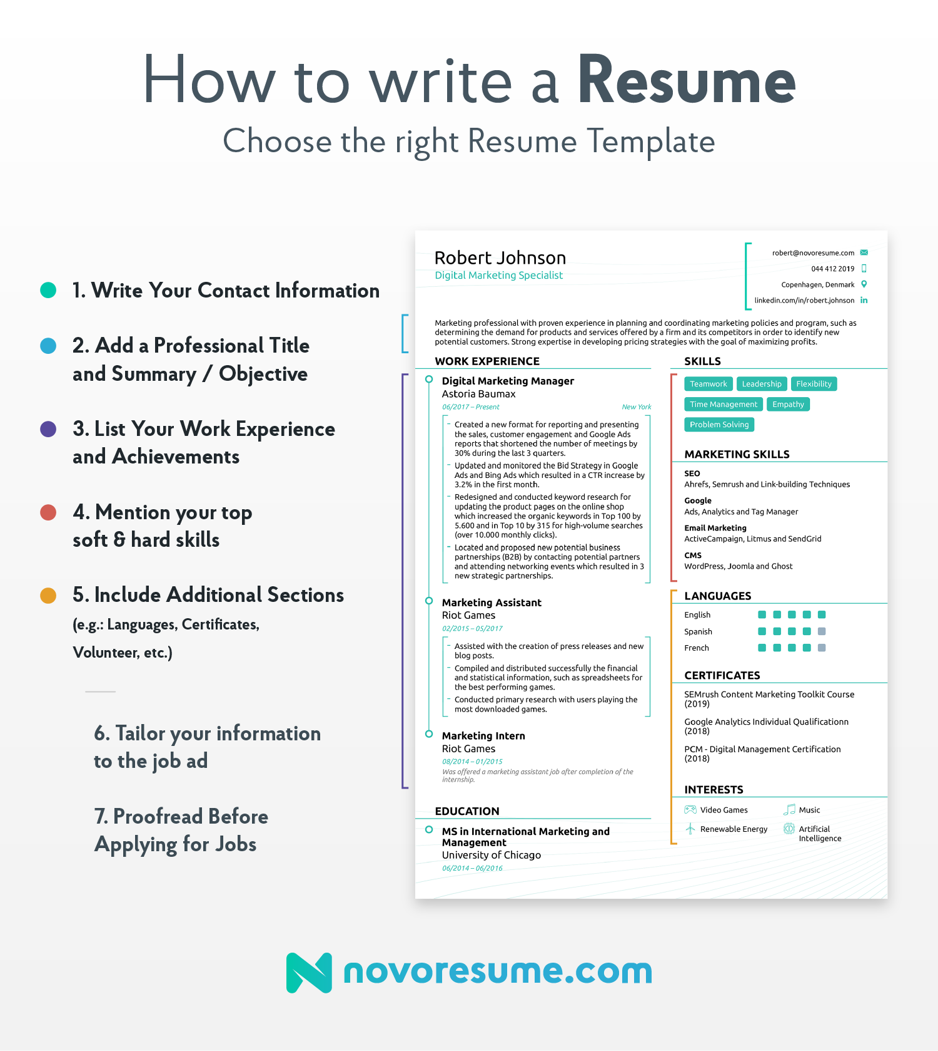
https://novoresume.com/career-blog/how-to-write-a-resume-guide

Slide 5
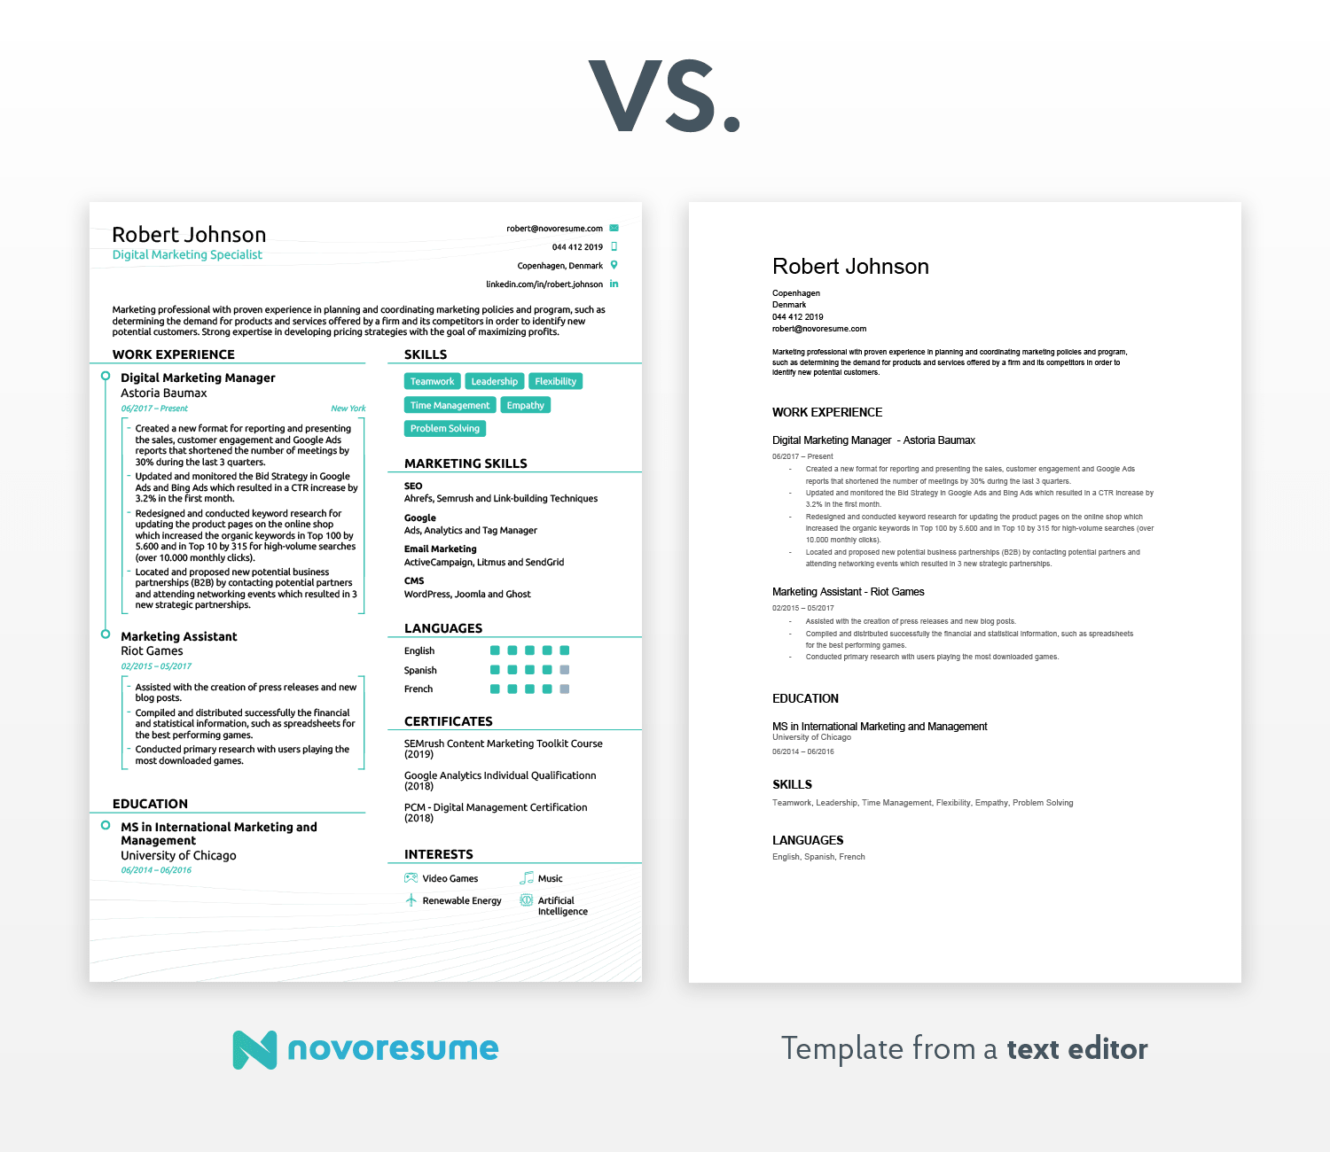

Slide 6
The 3 resume formats are:
1) Reverse chronological resume format (90%) - This is the most popular resume format and is ideal for people with plenty of work experience that is relevant to the position they’re interested in.
2) Functional/skills-based resume format – If you lack relevant work experience because you are a student/recent graduate, or you are looking to make a career change, the skills-based format is a better choice.
3) Combination resume format – The combination resume is a great choice for job-seekers with a very diverse skill-set. It’s useful if you’re applying for a role that requires expertise in 3-4 different fields, and you want to show all that in your resume. Say, for example, you’re applying for a senior management role, and the requirements are expertise in Management, Sales, and Software Development.

Slide 7
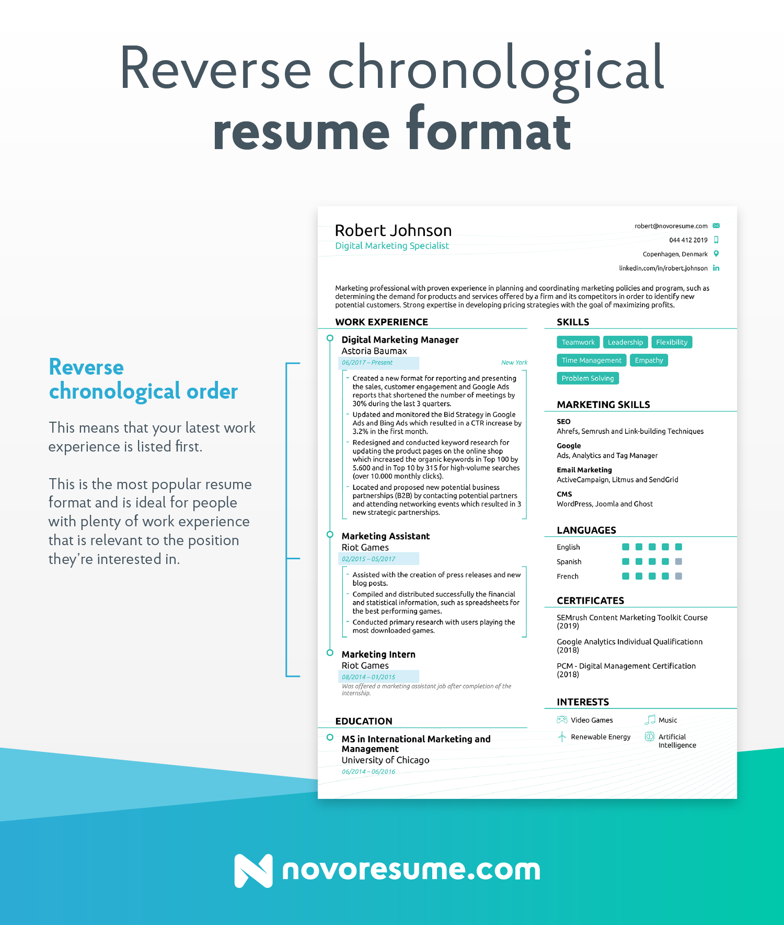

Slide 8
Resume Layout Must-Haves
1. One page in length. You should only go for 2 pages if you really, really believe that it’ll add significant value. HR managers in big firms get around 1,000+ resumes per month. They’re not going to spend their valuable time reading your life story!
2. Clear section headings. Pick a heading (H2, for example) and use it for all the section headers.
3. Ample white-space, especially around the margins.
4. Easy-to-read font. We’d recommend sticking to what stands out, but not too much. Do: Ubuntu, Roboto, Overpass, etc. Don’t (ever): Comic Sans
5. Pick the right font size. As a rule of thumb, go for 11 - 12 pt for normal text, and 14 - 16 pt for section titles.
6. As a rule of thumb, save your resume as PDF. Word is a popular alternative, but it has a good chance of messing up your resume formatting.
One more thing you need to consider in terms of resume layout is whether you’re going for a traditional-looking resume or something a bit more modern:

Slide 10
Resume Content - What to Mention on Your Resume
Now that we’ve got the basics out of the way, let’s dive into the essentials of how to write a resume.
The most popular sections for a resume are:
Contact Information
Professional Resume Summary or Objective
Work Experience (and Achievements)
Education
Skills
Optional Sections - Languages, Publications, Hobbies, etc.
Contact Information
The most critical section in your resume is the “contact information.”
Even if you get everything else right, you’re not going to go far if the HR manager can’t get in touch with you because you misspelled your email.
Make sure to double-check, and even triple-check your contact information section and make sure everything is correct and up-to-date.

Slide 11
Contact Information to be Included in a Resume
Must-have Information
First Name / Last Name
Phone Number.
Email Address.
Location - are you located in the area, or will the company have to sponsor relocation?
Optional Information
Title - Your professional title. It can be your position, word-for-word, or your desired job. Think “Digital Marketing Specialist” or “Junior Data Scientist.”
LinkedIn URL - If you have an up-to-date profile that can add value to your application, make sure to include the link.
Social Media - Do you have a published portfolio online? For developers, this would be your GitHub, for a designer Behance or Dribble and for a writer, it could be your personal blog.
Website / Blog - Do you have an online presence? Maybe a blog that positions you as an expert in your field? If you do, make sure to mention it!
What NOT to Include in the Contact Info Section
Date of Birth (unless specifically required in the job ad) - The HR manager doesn’t need to know how old you are. It’s not important for their decision-making, and at worst, it might lead to discrimination based on age.
Unprofessional Email Address - Do: name.lastname@gmail.com Don’t: player69@gmail.com
Headshot - The HR manager doesn’t need to know what you look like in order to evaluate your application, so there’s no real need to include it.

Slide 12
Example of contact information

Slide 13
Resume Summary or Objective
It’s not a secret for anyone that first impressions matter, whether they’re in your personal life, or your career.
If you leave a bad first impression, chances are, it’s there to stay. After all, it’s very hard to change someone’s opinion of you.
The same applies to your job search - the HR manager spends around 6 seconds scanning each resume. Yep, your carefully-worded, hand-crafted resume only gets 6 seconds of attention. Unless, of course, you manage to leave an amazing first impression.
The way you accomplish this is through either a good resume summary or objective. Both are placed at the top of your resume, right around the contact information section:

Slide 14
What’s a Resume Summary & When to Use it
A resume summary is a 2-3 sentence summary of your career. You should use a resume summary in basically any situation, unless you’re a recent university graduate or switching careers (in that case, you use a resume objective. More on that later!).
In your resume summary, you need to mention:
Your job and years of experience. E.g.: Customer support representative with 5+ years of experience in the IT industry.
1 or 2 top achievements (or core responsibilities). E.g.: Specialized in technical support, customer care, and user retention.
Desired goal (generally, passion for working at a specific company). E.g.: Looking for new opportunities as a support lead for a SaaS company.
And here’s how the resume summary looks on a resume:

Slide 15
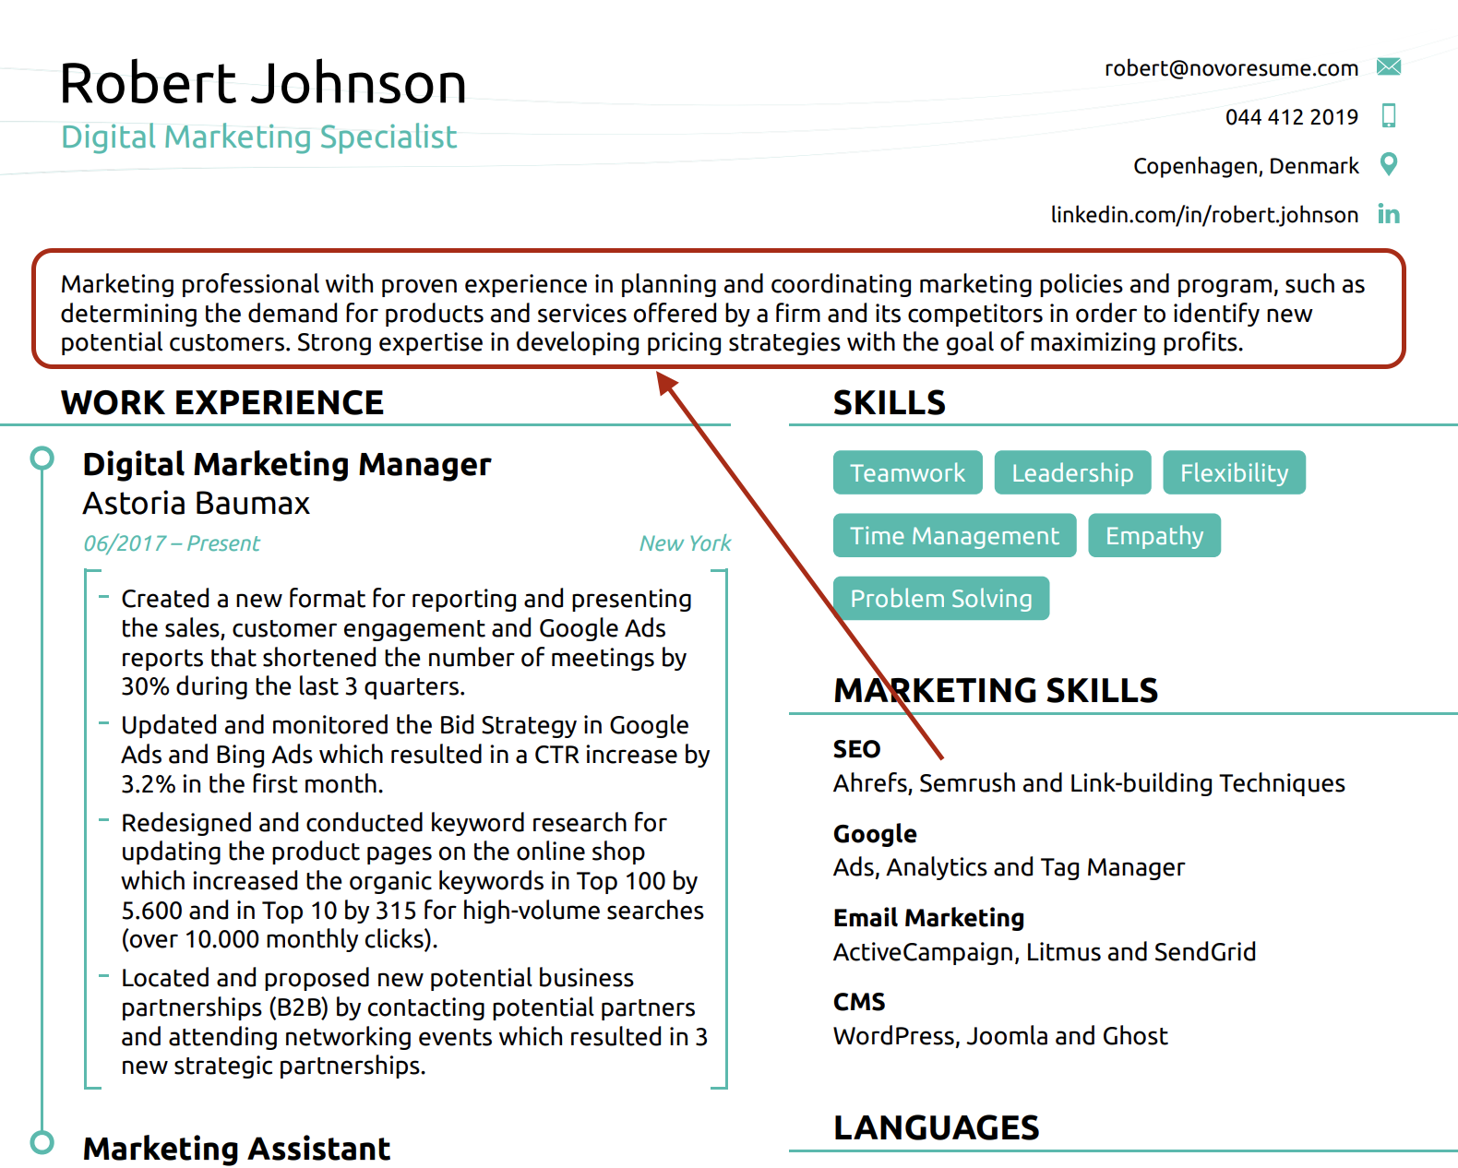

Slide 16
How to List Work Experience in a Resume
The standard format for your work experience is as follows:
Job Title/Position - Your job title goes on top of each work experience entry. When the HR manager scans your resume, you want them to know, at a glance, that you have relevant work experience for the job.
Company Name / Location / Description - Then, you mention the name of the relevant employer, as well as the location of the office you work/have worked in. In some cases, you may also want to briefly describe the company, if the organization is not a famous household name.
Achievements and Responsibilities - This is the core of each work experience entry. Depending on your field, you want to list either your achievements or responsibilities. We’ll get more into the how’s and why’s of this in a bit.
Dates Employed - The timeframe of your employment in each company. Not sure about the exact dates you worked somewhere? Don’t worry - you don’t have to be accurate by the day, as long as it’s close. The standard format expected by recruiters and employers is mm/yyyy (this is especially important when your job application will be parsed by an Applicant Tracking System).

Slide 17
What’s a Resume Objective & When to Use it
A resume objective is, in a nutshell, the goal of your resume. It communicates your motivation for getting into a new field. As with a resume summary, a resume objective should be around 2-3 sentences.
As we’ve mentioned before, a resume objective is the go-to for anyone that either has no work experience or is going through a career change.
Formula to Create Your Resume Objective:
(1) [SKILL/EDUCATION/CERTIFICATION RELEVANT TO THE JOB WITH JOB TITLE].
Looking to apply my (2) [years/months of EXPERIENCE RELEVANT TO THE JOB DESCRIPTION] at [COMPANY YOU ARE APPLYING TO]
to help (3) [TYPE OF RESPONSIBILITIES YOU WILL HELP OUT WITH SUCCESSFULLY].
Examples of Resume Objectives
1) So, here’s how that would look like if you’re a student:
“Hard-working recent graduate with a B.A. in Graphic Design from New York State University seeking new opportunities. 3+ years of practical experience working with Adobe Illustrator and Photoshop, creating illustrations & designing UX / UI. Looking to grow as a designer, as well as perfect my art, at the XYZ Design Studio.”
2) Or, on the other hand, if you’re going through a career change:
“IT project manager with 5+ years of experience in software development. Managed a team of developers to create products for several industries, such as FinTech and HR tech. Looking to leverage my experience in managing outsourced products as a Product Owner at XYZ.”

Slide 18
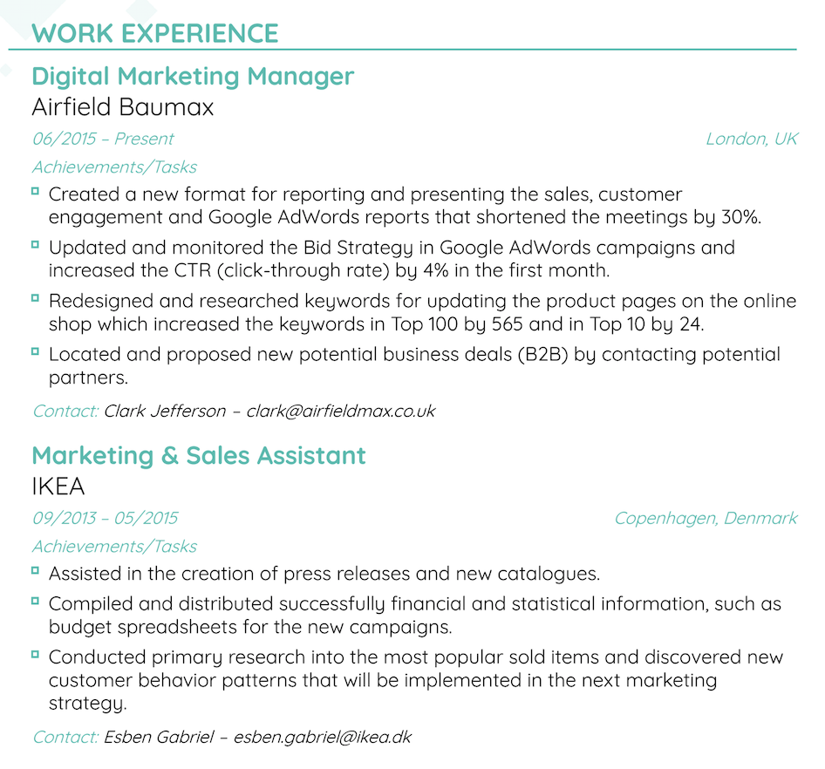

Slide 19
List Achievements When Possible
One of the most common resume mistakes is listing only responsibilities in your work experience section.
Here’s the thing - in most cases, the hiring manager knows what, exactly, your responsibilities were. Let’s say you’re a sales manager, for example. Your responsibilities would be:
Reach out to potential clients over the phone or email.
Maintain relationships with existing company clients and upsell relevant products.
Tracking and reporting on leads in CRM.
Coincidently, this is exactly the same list of responsibilities for every sales manager. 90% of all other resumes probably mention just about the same thing.

Slide 20
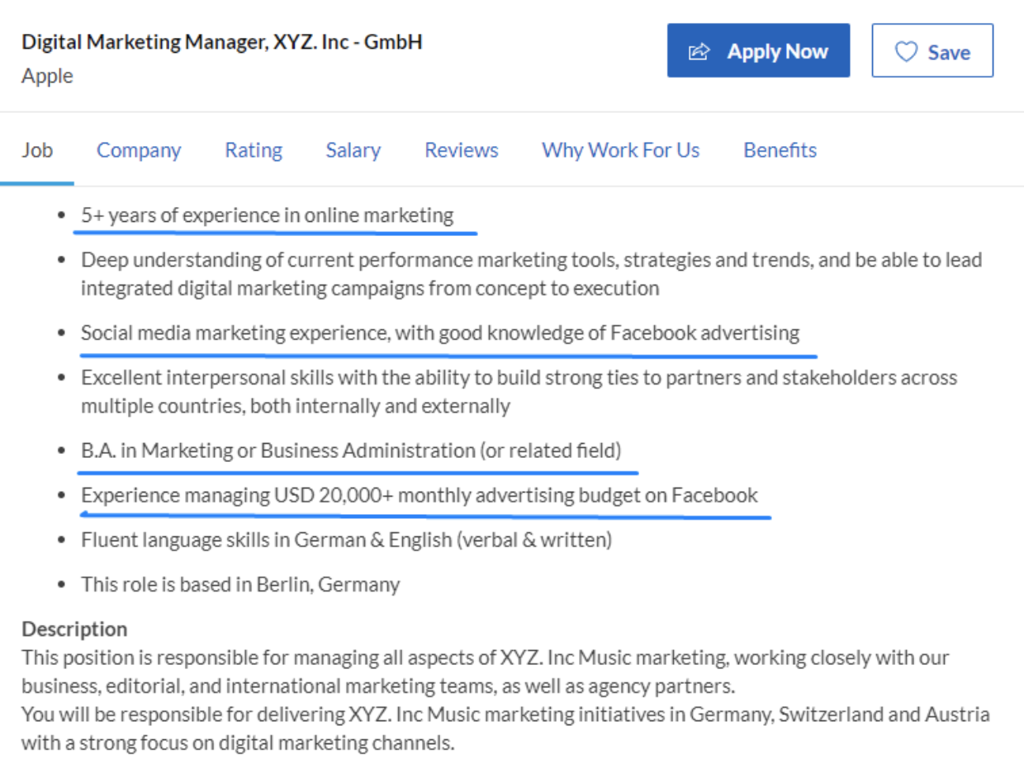

Slide 21
How to List Education on Your Resume
The next section we’re going to cover is your Education. Let’s start with the basics - how to format the education section & what to mention there. Then, we’ll move on to tips & tricks that’ll help you stand out…
Program Name. E.g.: “B.A. in Business Administration”
University Name. E.g.: “New York State University”
Years Attended. E.g.: “08/2008 - 06/2012”
(Optional) GPA. E.g.: “3.9 GPA”
(Optional) Honors. E.g.: Cum Laude, Magna Cum Laude, Summa Cum Laude.
(Optional) Academic achievements. Any interesting papers you’ve written, courses you’ve excelled in, etc.
(Optional) Minor. “Minor in Psychology”
Here's an example:

Slide 22
How to List Education on Your Resume
The next section we’re going to cover is your Education. Let’s start with the basics - how to format the education section & what to mention there. Then, we’ll move on to tips & tricks that’ll help you stand out…
Program Name. E.g.: “B.A. in Business Administration”
University Name. E.g.: “New York State University”
Years Attended. E.g.: “08/2008 - 06/2012”
(Optional) GPA. E.g.: “3.9 GPA”
(Optional) Honors. E.g.: Cum Laude, Magna Cum Laude, Summa Cum Laude.
(Optional) Academic achievements. Any interesting papers you’ve written, courses you’ve excelled in, etc.
(Optional) Minor. “Minor in Psyc
Example

Slide 23
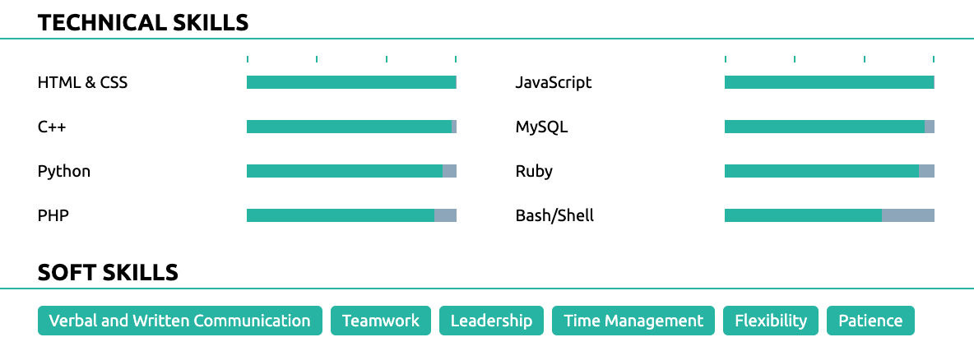
How to write about your skills?
Emphasize Your Know-How with the Skills Section
Another must-have section in your resume is the “Skills” section. Here, you want to mention all your know-how that makes you the perfect candidate for the job.
There are 2 types of skills you can include when writing your resume:
Hard Skills (Measurable abilities). This can be anything from coding in Python to knowing how to cook Thai cuisine.
Soft Skills (Personal skills). These are a mix of social skills, communication skills, personal traits, career attributes, and so on. Leadership, critical thinking, management, and communication, just to name a few.
A good resume should cover both.
Beginner - some experience with the skill, whether it’s from some entry-level practice or classroom education.
Intermediate - the skill in a work environment with a good level of understanding.
Advanced - the go-to person for the skill in your office; a coach other employees, and understand the skill on a high level.
Expert - You’re the go-to person for advice about the skill, not just in your office, but even amongst some of the best professionals in your field.

Slide 24
Step #3 - Include Some Universal Skills - “Universal Skills” are the type of skills useful for almost any job out there.
These are both soft skills (leadership, teamwork, critical thinking, etc.) and hard skills (Excel, Powerpoint, Photoshop, writing, etc.).
Whatever job you’re applying to, chances are, these skills will in one way or another come in handy, so feel free to include them, even if they’re not specifically required for the position.
Languages: native, fluent, proficient, intermediate, basic
Hobbies & Interests
Volunteering Experience
Certifications & Awards
Publications
Projects

Slide 25
Free Checklist for Resume Writing
Does your contact information section have all the must-have information?
Is your contact email professional? E.g.: firstname+lastname@email.com
Are you using the right resume format?
Is your resume 1-2 pages?
Did you include all the must-have sections in your resume?
Did you list only the most relevant work experiences?
Did you list achievements instead of responsibilities?
Did you tailor your resume to the job ad you’re applying for?
Did you mention the right amount of work experience in your resume?
Did you list your education in your resume?
Did you list all the right skills for the position you’re applying for?
Did you add any other important resume sections?
And finally, did you proof-read your resume? We’d recommend asking a friend or using software like Grammarly.

Slide 26
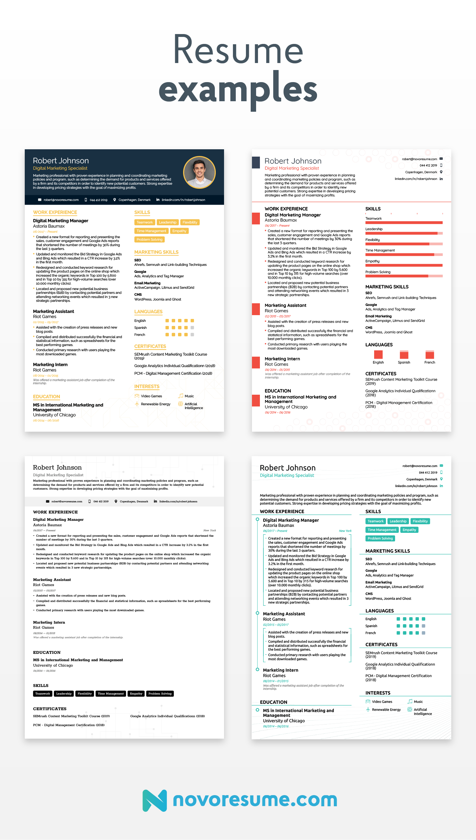

Slide 27
A Convincing Cover Letter
Every job application consists of 2 parts - the resume and the cover letter.
Here’s a format you could follow:
Introduce yourself (and leave an impression) - As a start, give a brief run-down on your work experience and mention why you’re interested in working for the company you’re applying for. You can also mention 1-2 of your top professional achievements to leave a good first impression.
Explain how you’d excel at the job - Identify the top 3 requirements in the job ad. Then, dedicate one paragraph to explaining how you fulfil each requirement. So for example, if the requirement is “Facebook Advertising Experience,” mention how you have done Facebook ads in the past and how you’ve excelled at it.
Wrap it up and say thanks - Thank the reader for reading your cover letter and propose the next steps. For example, “If you’d like to know more about my experience with Project XYZ, I’d love to chat!”

Slide 28
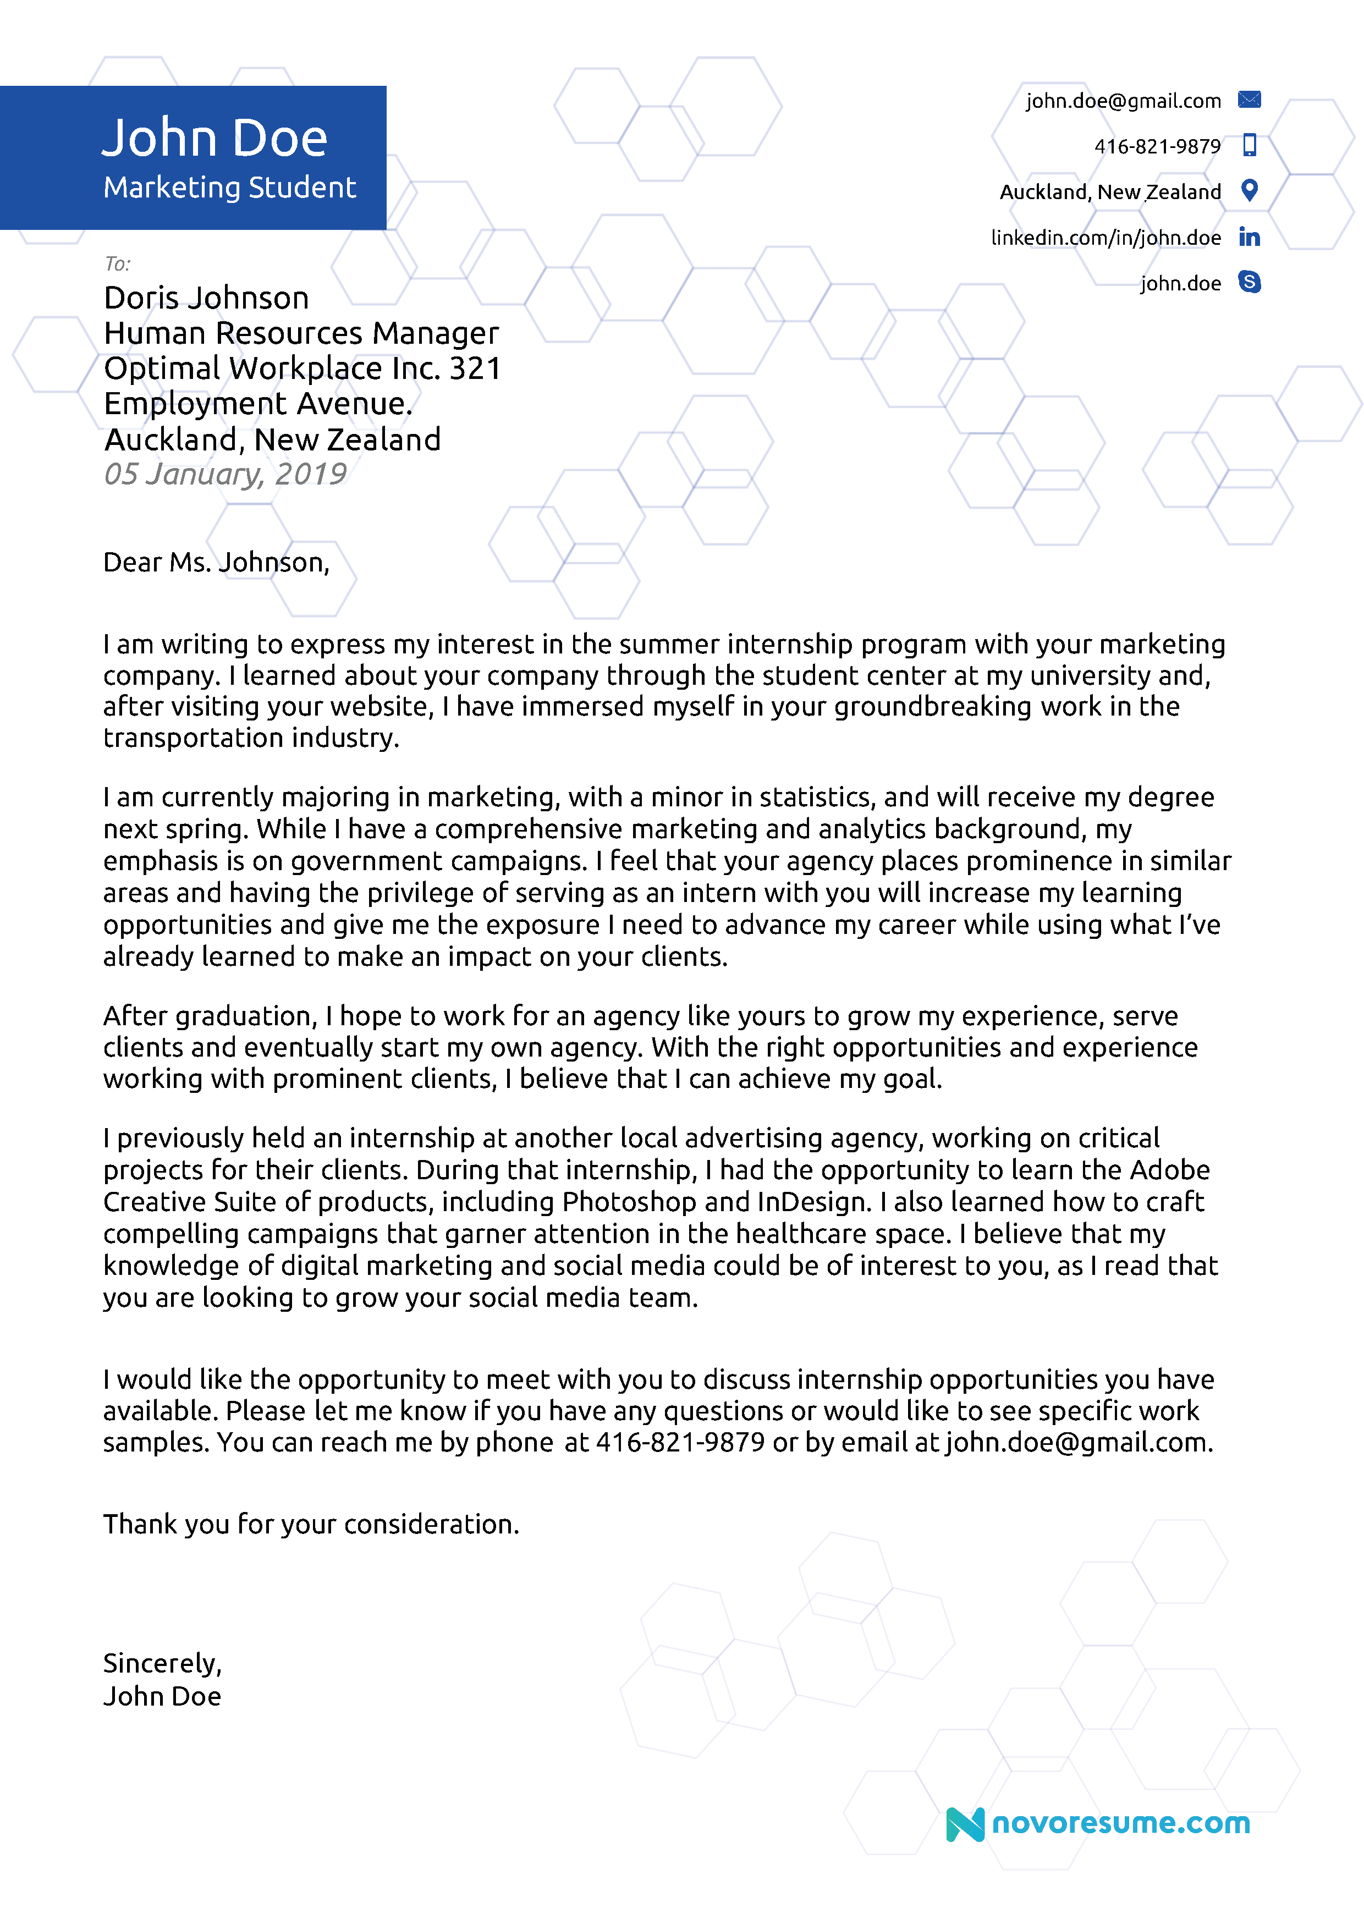
5+ cover letter examples.

Slide 29
references
1. How to write a resume
https://novoresume.com/career-blog/how-to-write-a-resume-guide

Slide 30
How to Write a Curriculum Vitae (CV) for a Job Application

Slide 31
Here’s how to write a CV:
Make sure you know when to use a CV
Pick the best CV format
Add your contact information the right way
Start with a CV personal profile (CV summary or CV objective)
List your relevant work experience & key achievements
Build your CV education section correctly
Put relevant skills that fit the job opening
Include additional CV sections to impress the recruiter
Organize this all on a professional CV template
Complement your CV with a cover letter
https://zety.com/blog/how-to-write-a-cv

Slide 32
Curriculum Vitae Meaning
A CV (short for the Latin phrase curriculum vitae, which means “course of life”) is a detailed document highlighting your professional and academic history
In the US, Canada, and Australia, a CV is a document you use for academic purposes.
The US academic CV outlines every detail of your scholarly career.
In other countries, CV is an equivalent of an American resume.
You may be asked to submit a CV when applying for jobs in academia or a job outside the US.

Slide 33
CVs typically include information like:
Work experience
Achievements and awards
Scholarships or grants you’ve earned
Academic coursework
Research projects
Publications of your work

Slide 34
Sample CV Format
CV Header with Contact Information
Personal Profile: CV Objective or CV Summary
Work Experience
Education
Skills
Additional Sections

Slide 35
The gold CV formatting rules
1. Choose clear, legible fonts
- Go for one of the standard CV typefaces: Arial, Tahoma, or Helvetica if
you prefer sans-serif fonts, and Times New Roman or Bookman Old
Style if serif fonts are your usual pick.
- Use 11 to 12 pt font size and single spacing. For your name and section
titles, pick 14 to 16 pt font size.
2. Be consistent with your CV layout
- Set one-inch margins for all four sides. - Make sure your CV headings are uniform—make them larger and in bold
but go easy on italics and underlining.
- Stick to a single dates format on your CV: for example 11-2017, or
November 2017.

Slide 36
The gold CV formatting rules
Don’t cram your CV with gimmicky graphics
- Less is more.
- White space is your friend—recruiters need some breathing room!
Plus, most of the time, after you send out your CV, it’s going to be printed
in black ink on white paper. Too many graphics might make it illegible.
Get photos off of your CV
- Unless you’re explicitly asked to include your photograph in the job ad.
- If so—make sure to use a professional looking picture, but not as stiff as
an ID photo.

Slide 37
The gold CV formatting rules
Make your CV brief and relevant
Don’t be one of those candidates stuck in the nineties who think they have to include every single detail about their lives on their CVs.
Hiring, nowadays, is one hell of a hectic business. Nobody’s got the time to care for what high school you’ve attended or to read 10+ bullet point descriptions of past jobs. We’ll get to that later on.
Pro Tip: Once you’ve finished writing, save your CV in PDF to make sure your CV layout stays intact. But pay close attention to the job description. Some employers won’t accept a PDF CV. If such is the case, send your CV in Word.

Slide 38
How to Format a CV?
Set one-inch margins on all sides.
Use 1.0 or 1.15 line spacing.
Pick a good font for a CV and stick to it on the whole document.
Create a professional CV header format for your contact details.
Divide your CV into legible sections: Contact Information, Personal Statement, Work Experience, Education, Skills, Additional Information.
Make section headings slightly larger than the rest of the contents.
Add a blank line before and after each heading.
Save your CV in PDF to keep your formatting intact.

Slide 39
The Structure of a Standard Chronological CV Template
1. Contact Information
Full name
Professional title
Email address
Phone number
LinkedIn profile
Home address
2. Personal Statement (Summary or Objective)
If a CV personal statement is a brief (100 words tops), snappy paragraph at the top of your CV that provides an overview of your qualifications and skills. It works as a “trailer” for the rest of your CV. Fill it with keywords relevant to the job opening and explain why you’re the perfect candidate.
If you have years of relevant experience, write your personal statement as a CV summary: highlight your best professional achievements.

Slide 40
The Structure of a Standard Chronological CV Template
Not much experience yet? Go for a CV objective: summarise what skills you’ve mastered so far and how well you’d fit in.
Whichever one is right for you, don’t focus it solely on what you want out of the job. Instead, emphasize what you have to offer. For instance:
Dependable licensed NMC Registered Nurse trained to work in high-stress environments and stay calm under pressure. Seeking to leverage meticulous record-keeping and analytical skills to help St Francis Hospital with your upcoming challenges.

Slide 41
3. Work Experience
Start with your current or most recent job.
Below, list your previous jobs chronologically descending.
List: your job title, the name of the company, dates worked.
Below each entry, add up to 5 bullet points explaining your responsibilities and achievements.
Quantify whenever possible. Numbers pop!

Slide 42
4. Education
Graduation year (if you’re still studying, enter your expected graduation date)
Degree
Institution name
Sub-honours (if applicable)

Slide 43
5. Skills
Start with a spreadsheet with a master list of all the professional skills you’ve developed
Read the job ad carefully and look for skill-related keywords.
Those skills from your list that match the job description go on your CV.
Instead of just listing skills in a separate skills section, mention them in your CV personal statement and in the work history section.

Slide 44
6. Additional Sections
Industry awards
Professional certifications
Publications
Professional affiliations
Conferences attended
Additional training

Slide 45
Another type of CV
A skills-based CV format, also known as a “skills CV” or a “functional CV.”

Slide 46
Skills Based CV Structure
Contact Information
CV Objective
Skills Summary
Work Experience
Education
Additional Skills

Slide 47
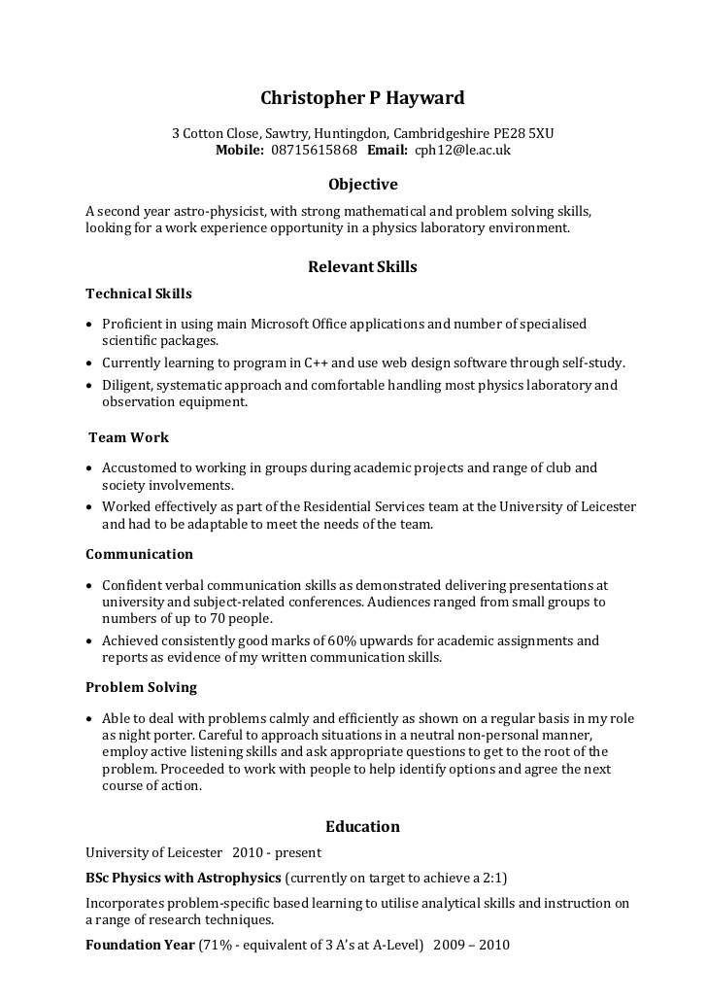
Example skilled based CV
https://zety.com/blog/cv-format#structure

Slide 48
CV vs. Resume
Resumes and CVs are not interchangeable
A Resume is a shorter-form document that provides a concise overview of your previous roles, skills and details about your education in the United States and most of Europe
A CV is typically a longer, more detailed document focused largely on academic coursework and research
In India, South Africa and Australia, the terms CV and resume are interchangeable

Slide 49
What is a CV?
A CV is a detailed document sharing your
− career history
− education
− awards
− special honors
− grants or scholarships
− research or academic projects
− publications
A CV may also include
− professional references
− coursework
− fieldwork
− descriptions of research projects or dissertations
− hobbies and interests
− a personal profile that lists your skills and positive attributes
Generally, a CV is chronological and starts with your educational experience

Slide 50
What is a resume?
A resume is a document that summarizes your career history, skills and education
A resume may also list relevant professional associations or volunteer work and may include an objective statement that shares your professional goals
The term resume originates from the French word résumé, which translates to “abstract” or “summary.”
Often people list their professional experience on a resume in reverse-chronological order, starting with their current or most recent job
If you are a recent graduate with little or no professional history, you would start with your education and then list any relevant internships or apprenticeships

Slide 51
CV vs. resume: what are the differences
Length: While most people strive to keep their resume as concise as possible, and ideally only one to two pages, a CV can run several pages in length. That’s because a CV includes more information than a resume.
Experience / career type: Often, CVs are used by people in academic roles. You may have a CV if you are currently applying to or have graduated from a masters or doctoral program, or if you work as a professor or researcher at an academic institution.

Slide 52
CV vs. resume: what are the differences
Ability to customize: A CV is a static document that does not change. You may add new information to a CV throughout your professional career, but the information will not change based on where you’re applying. A resume, on the other hand, is often tailored to highlight specific skills or experience relevant to the position or industry.
Geography: In other regions of the world, such as the UK, New Zealand and parts of Europe, employers use the term CV to describe both CV and resume-style documents and don’t use the term “resume” at all. In South Africa, Australia and India, the terms CV and resume are often used interchangeably. But, in the US, a resume and CV are two distinctly different types of documents.

Slide 53
